Slide 1
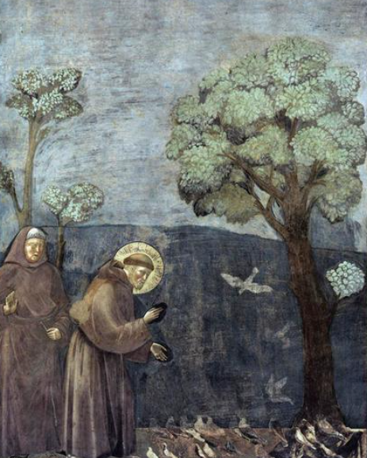
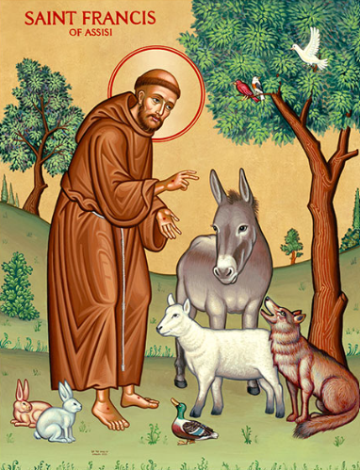
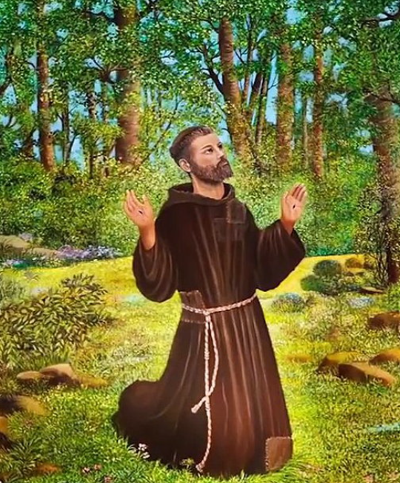

Year of St Francis

Slide 2

Gather
Laudato Si’
O Mi Signor
(Praise be to you, O my Lord)

Slide 3
Gather
St Francis:
A man who cared for all living things
and for people in need. He loved God.
How can you care for people,
creation and peace?

Slide 4

Listen
“Praise the Lord from the heavens;
praise him in the heights.
Praise him, sun and moon;
praise him, all shining stars…
Praise the Lord from the earth,
sea creatures and all depths…
Let them praise the name of the Lord,
for he commanded
and they were created.”
(Psalm 148)

Slide 5

Listen
https://www.youtube.com/watch?v=3X4tv19Muk4

Slide 6
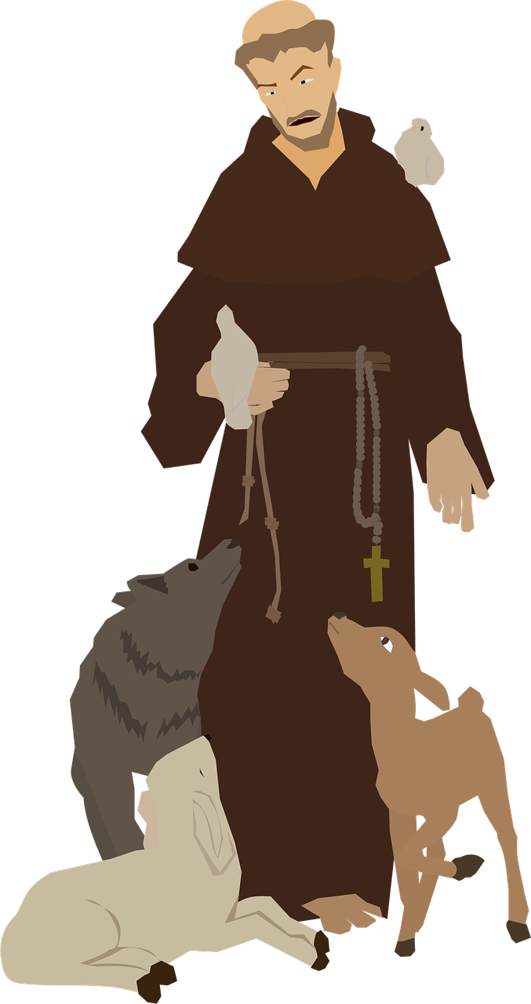
Respond
St Francis of Assisi lived many years ago. At first, he lived a comfortable life. But when he met people who were poor and sick, his heart began to change.
St Francis chose to live simply. He cared for people who were lonely or forgotten. He cared for animals, plants, and the Earth.
In the story of the Wolf of Gubbio, people were afraid. But St Francis did not use anger or force. He listened, spoke gently, and helped everyone choose peace instead of fear.

Slide 7
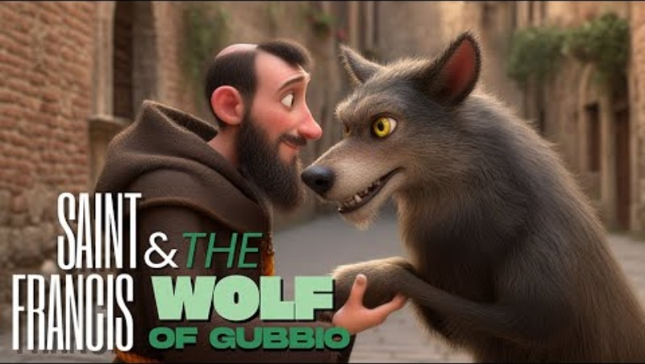
Respond
https://www.youtube.com/watch?v=X8ZHtwKga_o
Notes:
https://www.youtube.com/watch?v=X8ZHtwKga_o

Slide 8








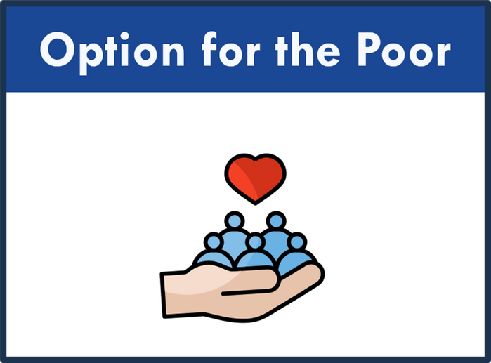
Respond

Slide 9
Respond

Slide 10

Reflecting on
St Francis
  • Who might need my care or kindness today?
  • How can I show care with my words or actions?
  • What is one thing I can thank God for today?
  • How can I care for God’s world at school or at home?
  • How can I be a peacemaker today?

Slide 11

Respond
  Reader: We will now pray together using an adapted prayer inspired by St Francis’ Canticle of Creation. Different voices will help us praise God for His world.
  Child 1: Praise be to you, God, for Brother Sun, who gives us light and warmth. All: Help us care for your world.
  Child 2: Praise be to you, God, for Sister Moon and the stars, shining in the night sky.
  All: Help us care for your world.

Slide 12
  Child 3: Praise be to you, God, for Brother Wind and the air we breathe, for clouds and rain.
  All: Help us care for your world.
  Child 4: Praise be to you, God, for Sister Water, so precious and life-giving. All: Help us care for your world.
  Child 5: Praise be to you, God, for Sister Earth, who feeds us, supports us, and gives us life.
  All: Help us care for your world.
Respond

Slide 13

Let us pray...
God of creation,
Teach us to live simply,
to care deeply,
and to walk gently with one another
and with the Earth.
Through the example of St Francis,
help us be people of
peace, care and hope.
Amen.

Slide 14

Mission: St Francis
• Care for something living today.
• Speak kindly and gently to others.
• Forgive someone who has hurt you.
• Protect a shared space.
• Reduce waste or reuse something.
Or choose your own mission.

Slide 15
Send Forth
Make me a channel of Your peace

