Slide 1
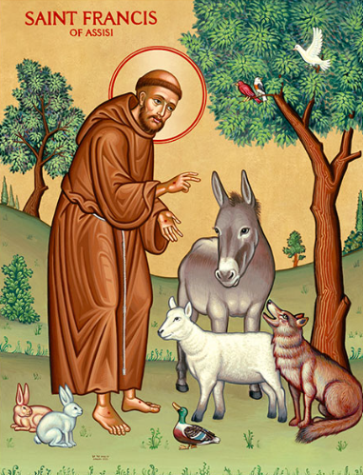

Year of St Francis: Resource Pack
Prayer, Reflection & Creative Response

Slide 2
How to use this pack
Year of St Francis: Resource Pack
What this is
Prayerful, creative and reflective ideas inspired by St Francis of Assisi.
Designed to support prayer spaces, displays, outdoor reflection and spiritual development across the year.
How to use
Optional • Non-linear • Adaptable for EYFS to Secondary
Choose what fits your pupils and context. Adapt / amend.
Related Romero Award resources
• Year of St Francis – Celebration of the Word
(Primary & Secondary | PPT and Word)
• Catholic Social Teaching Principle Resources
(for structured classroom work and displays)
What can YOU do?

Slide 3







Prayer Areas and Displays
Templates may be enlarged and printed for
creative prayer and reflection. Pupils may write,
draw, dictate or respond with a word or symbol.
Dove – Peace: eg “Help me be a peacemaker by…”
Bird / feather – Creation: e.g. “Thank you, God, for
creation. I promise to care by…”
Earth – Our Common Home:
e.g. “This year, I will care for our world by…”
Leaf / Plant / Tree – Growth and Simplicity:
e.g. “Help me grow in kindness by…”

Slide 4
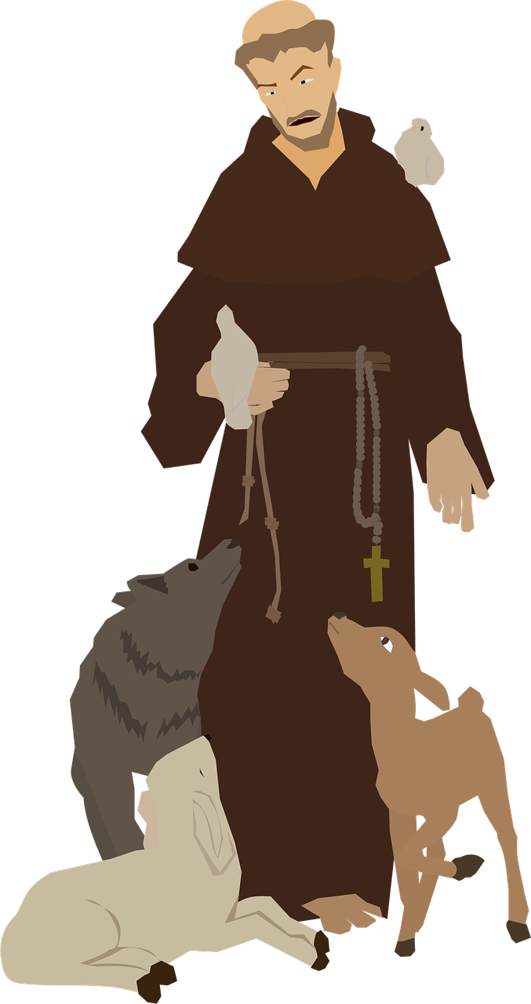
Symbols for Prayer Times / Displays
Possible symbols linked to St Francis
Plant / soil / natural objects: St Francis is patron saint of ecology and the environment. He loved creation and believed it was God’s gift to be cared for.
Animal or pet photo / toy: St Francis is the patron saint of animals and birds and showed kindness to all living things.
Cross: St Francis chose to follow Jesus’ way of love, peace, and sacrifice.
Dove: His life embodies peace, humility and finding happiness in love for God, making him a symbol of peace.
Crib / nativity figure: St Francis created the first nativity scene to help people understand Jesus’ birth.
Image of St Francis with marks on his hands (for older pupils): These represent the stigmata — showing how deeply he shared in Jesus’ suffering.

Slide 5
Prayer Walk
Season | What to notice | Simple prayer activity | Reflection focus | CST link
Spring | New life: buds, leaves, insects, grass | Quiet walk to notice new life. “Help us grow in kindness and care. | • What is growing? • How do people grow when they are cared for? | Care for Creation Human Dignity
Summer | Light, warmth, colour, beauty | Slow “praise walk” — stop and name something beautiful. “Praise be to You, Lord God.” | • What makes me feel thankful? • Where can I see beauty around and inside me? | Common Good Creation (Gratitude)
Autumn | Changing colours, falling leaves, seeds | Observe or collect leaves; think about letting go. “Help us choose peace.” | • What helps us choose peace? • What do we really need? | Peace Solidarity
Winter | Cold, stillness, bare trees — find colour | Colour hunt in grey spaces. “Thank you, God, for hope.” | • Where can we find hope? • How do we care for others in hard times? | Human Dignity Option for the Poor

Slide 6
Outdoor Prayer: General
Activity | Description | Prayer focus
Artist’s Palette of Creation | Collect or draw different colours and textures | “Thank you, God, for variety and beauty.”
Nature Frame Prayer | Frame something beautiful with sticks or paper | “Thank you, God, for…”
Creation Thank-You Circle | One word or phrase of thanks | Gratitude and praise
Quiet Sit & Listen | Sit silently and notice sounds | Stillness and presence

Slide 7
St Francis of Assisi – Did You Know?
His feast day is 4 October – often marked by blessings of animals
As a young man, Francis dreamed of being a soldier and came from a wealthy family
He gave up riches to live simply and serve God and the poor
He is the patron saint of ecology and the environment
He is also the patron saint of animals and is often shown with birds or wolves
He wrote prayers and songs, including the Canticle of the Creatures
He met the Sultan during the Crusades, choosing dialogue and peace over violence
Challenge:
What else can you discover about St Francis?

Slide 8
St Francis of Assisi – More Did You Know?
Human / relatable
Francis struggled with illness and doubt, not instant holiness
His father was a successful cloth merchant — Francis was expected to inherit the business
He was known for his joy and sense of humour, even when living simply
Faith & prayer
Francis rebuilt a ruined church with his own hands after hearing God call him
He believed joy and gratitude were signs of true faith
He often prayed outdoors, close to nature
Peace & courage
He travelled into a war zone to meet the Sultan of Egypt during the Crusades
He believed peace begins with listening, not winning arguments
He refused to use violence, even when it would have made him safer
Creativity & influence
He wrote prayers that later inspired hymns and songs still sung today
He founded the Franciscan Order, which continues worldwide
Pope Francis chose his name to reflect Francis’ values of peace, simplicity and care

Slide 9
Optional Catholic Resource Links
For teacher planning, displays, prayer, reflection
Canticle of the Sun / Care of Creation prayer resources
Creation Family Prayer Ideas (CAFOD)
Laudato Si’ video for Children (Primary)
Laudato Si’ Celebration of the Word (Primary)
Catholic Social Teaching Resources (CAFOD)
Vatican / Catholic Teaching
Laudato Si’ – Papal Encyclical (Pope Francis)
Prayer for Our Earth (Pope Francis)

