Slide 1


Resources for Inclusion

Slide 2
How to use these slides
This presentation is a flexible, inclusive teaching resource, not a fixed lesson. Select, adapt and reorder slides to suit your pupils, setting and learning focus.
Whole class — Introduce, explore, discuss and reflect on key ideas.
Groups & 1:1 — Revisit or extend learning using visuals, questions and activities.
Different levels — Choose simpler or more challenging tasks to support and extend learners.
Across the curriculum — Use in RE, prayer, music, PSHE/RSHE and wider school life.
Adapt freely — Add photographs, Widgit Symbols, Makaton, AAC, objects of reference or local examples.
Companion Resource
Use alongside the ORA Stewardship of Creation Resource Booklet for further activities, inclusive approaches, Scripture, prayer, discussion prompts, planning guidance and opportunities for greater depth and challenge.

Slide 3
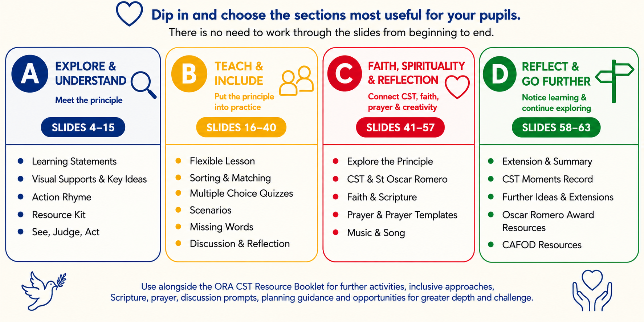
Contents

Slide 4

This PowerPoint alongside the Stewardship of Creation Resource Booklet will help pupils to do the following:
☐ I can explain what Stewardship of Creation means.
☐ I can describe what a steward does.
☐ I can recognise creation as a gift from God.
☐ I can make choices that care for our Common Home.
☐ I can use resources wisely and reduce waste.
☐ I can care for plants, animals and shared places.
☐ I can explain what the Bible teaches us about caring for creation.
☐ I can explain how St Oscar Romero inspires us to care for people and our Common Home.
☐ I can choose one way to care for God’s world and put it into action.
See CST Moments at the end of this PPT and in the Stewardship of Creation Resource Booklet

Slide 5

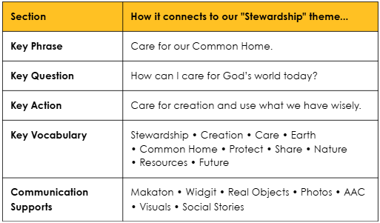

Slide 6

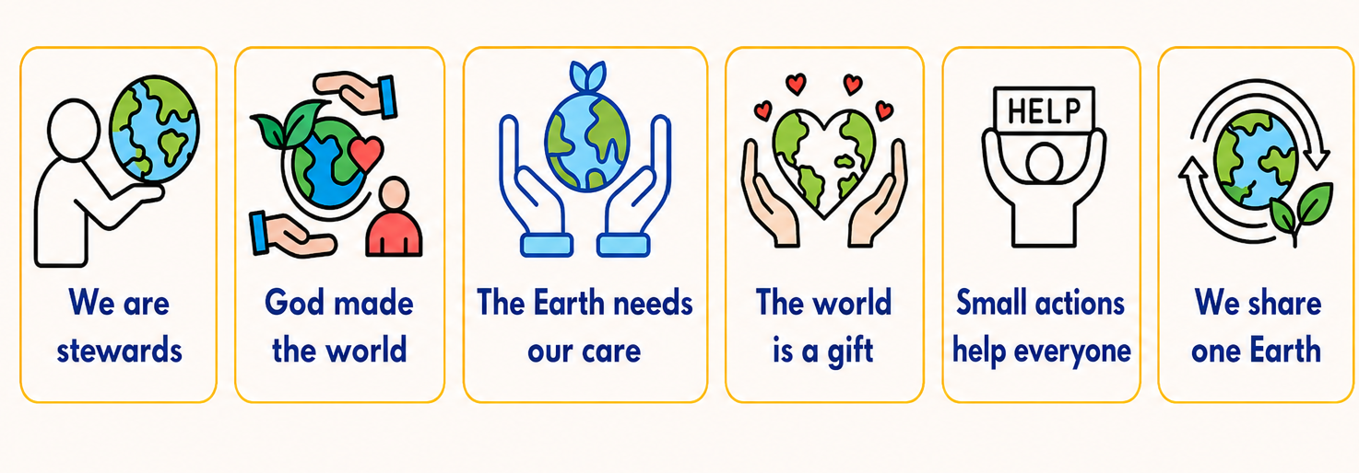
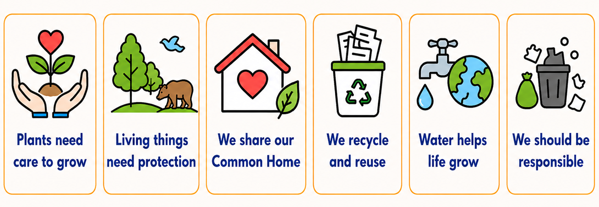

Slide 7
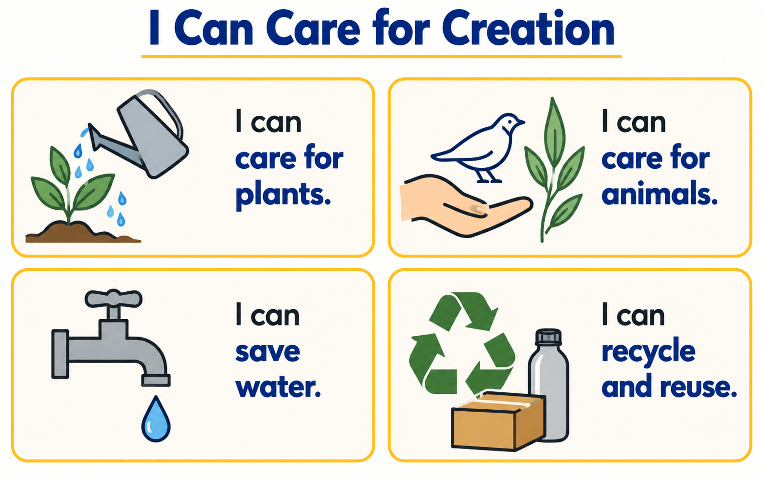

Slide 8
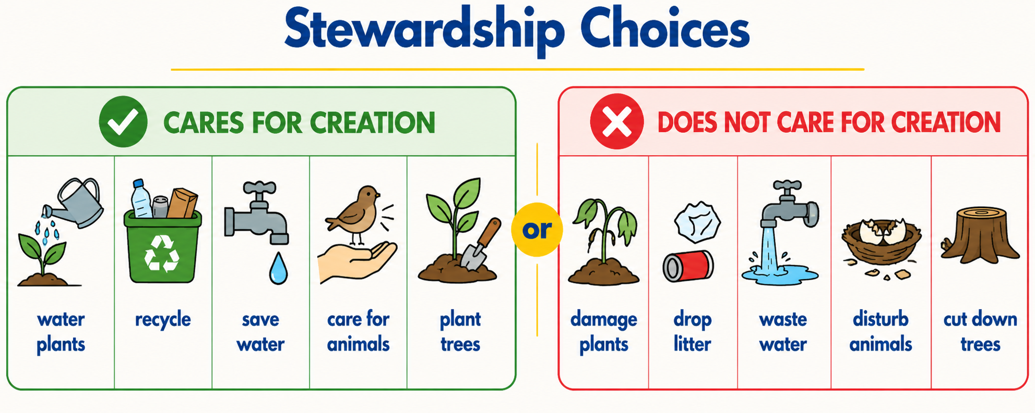

Slide 9

God made the world,
(Make a large circle with arms above the head)
A gift for us to share.
(Hold hands out as if receiving a gift)
God looked and said, “It is good!”
(Give two thumbs up)
So we will show we care.
(Cross hands over the heart)
We’ll help and love creation,
(Mimic digging or planting)
Our Common Home we share.
(Make a roof shape over the head)
(

Slide 10

Pupils can explore, choose, point to or discuss these optional objects during teaching, reflection and prayer.
A globe or large ball: To represent the whole world.
A small potted plant or seeds: To represent growth and our role in caring.
A watering can or spray bottle: To represent caring for creation.
Natural treasures: A leaf, stone and shell to represent land, sea and air.
A heart shape: To represent our love for God’s gift.

Slide 11

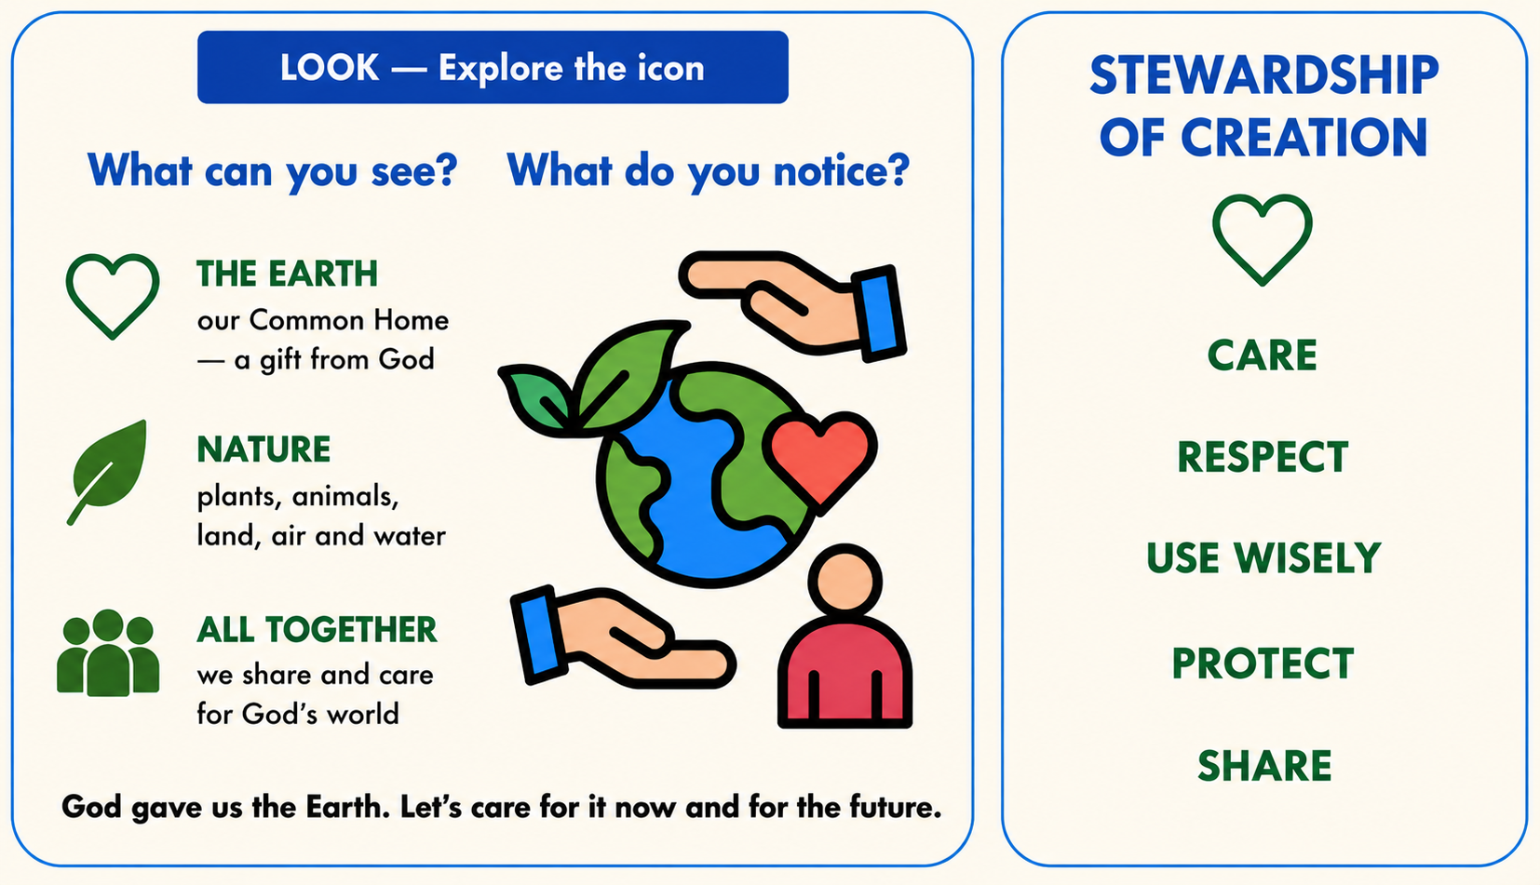
For a more detailed lesson plan, see the Stewardship of Creation Resource Booklet

Slide 12
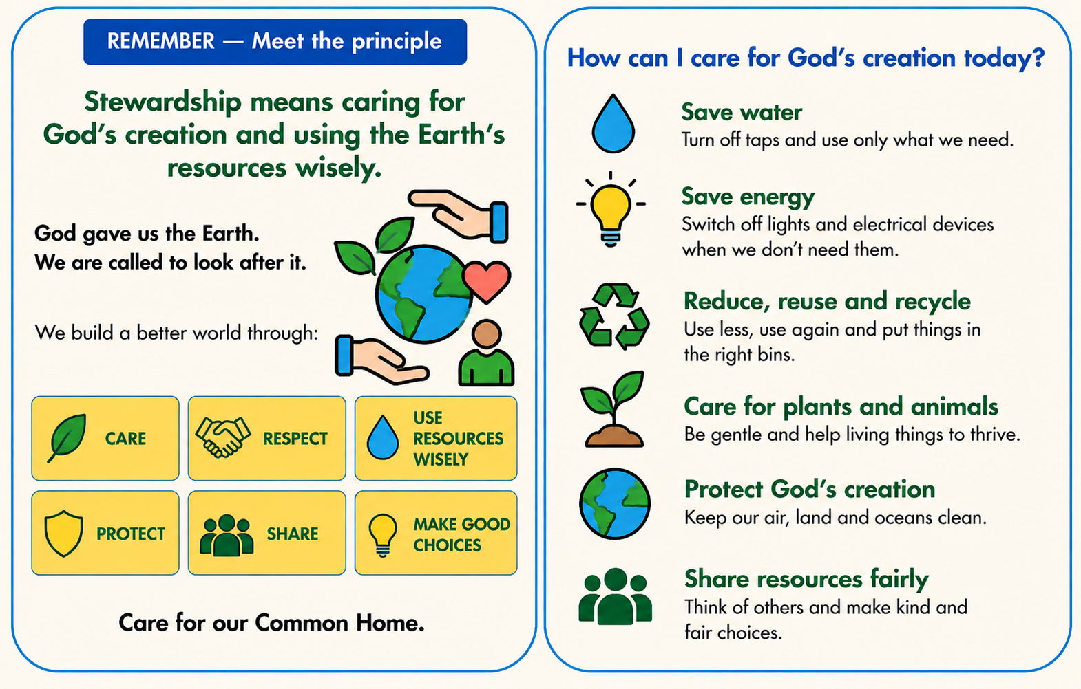
For a more detailed lesson plan, see the Stewardship of Creation Resource Booklet

Slide 13
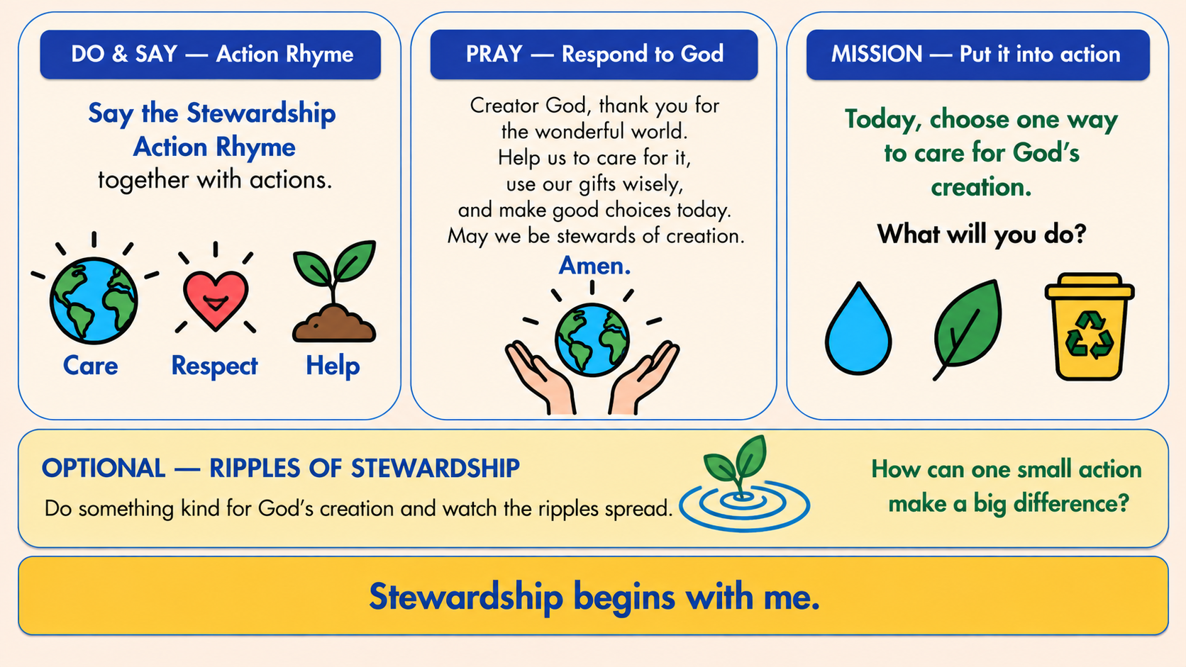

For a more detailed lesson plan, see the Stewardship of Creation Resource Booklet

Slide 14

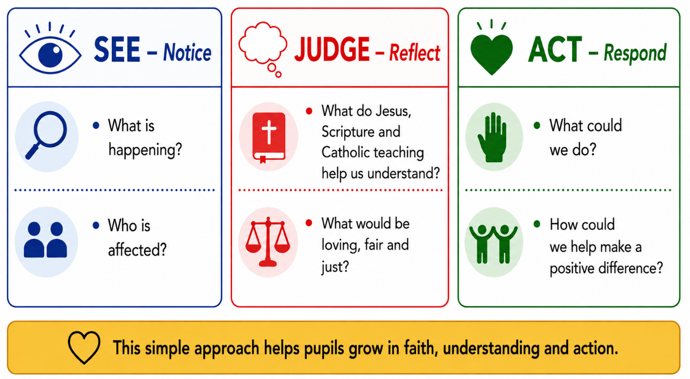
Use with a photograph, story, scenario, news item or real-life situation. Pupils can respond through speech, signing, AAC, pointing, drawing or role-play. Model use of Scripture.

Slide 15
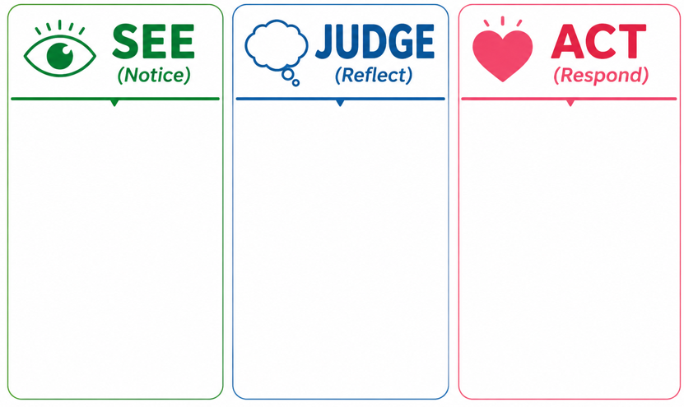

Slide 16

Teacher Notes
The following adaptable slides can be used as part of a planned sequence or as stand-alone activities.
1:1 work
Paired / group work
Whole class teaching in CST / RE
Introductory / plenary sessions
They can be used on a shared screen or printed as worksheets.
Some slides contain extra support or examples in the PPT notes.
They are separate from the ideas shared in the
Teacher Support PDF but are intended as springboards.

Slide 17


Slide 18
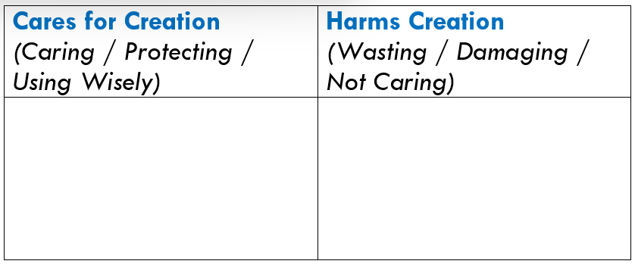
Option A: Put each letter in the correct column of the table
A) Dropping litter on the ground.
B) Putting paper in the recycling bin.
C) Leaving the tap running when you have finished.
D) Turning off a light when it is not needed.
E) Being gentle with plants and animals.
F) Wasting paper when you could use it again.
(See other ideas in PPT notes)
Notes:
A) Putting rubbish in the correct bin.
B) Pulling leaves off a healthy plant for fun.
C) Taking only the paper you need for an activity.
D) Leaving the classroom lights on when everyone goes out.
E) Helping to look after the school garden.
F) Throwing away something that could be reused.

Slide 19
Option A: Put each letter in the correct column of the table
A) Using both sides of a piece of paper.
B) Leaving rubbish behind after a picnic.
C) Helping to water plants that need it.
D) Picking flowers from the school garden without permission.
E) Taking more paper towels than you need.
F) Reusing a bottle or container instead of throwing it away.
(See other ideas in PPT notes)
Notes:
A) Turning off the tap while brushing your teeth.
B) Leaving litter at the beach or in a park.
C) Making something new from recycled materials.
D) Being rough with a small animal or insect.
E) Sharing resources instead of taking more than you need.
F) Picking up litter to help care for a shared place.

Slide 20

Cares for Creation Harms Creation
Mixed Scenarios
Turning off the tap
Dropping litter
Reusing paper
Wasting water
Caring for plants and animals
Leaving lights on when they are not needed
Challenge: Act out ways to care for God’s creation.
(See other ideas in PPT notes)
Notes:
Recycling paper, plastic and cans
Putting rubbish in the bin
Picking up litter
Leaving rubbish on the ground
Using only the water you need
Leaving the tap running
Switching lights off when you leave a room
Using both sides of a piece of paper
Throwing away paper that could be reused
Looking after trees and flowers
Pulling up plants for no reason
Being gentle with animals
Damaging an animal’s home
Growing plants and caring for them
Taking more than you need
Reusing bags and containers
Looking after books and resources
Breaking things on purpose
Donating things you no longer need
Walking or cycling when you can
Leaving doors or windows open when the heating is on
Keeping your local area clean
Protecting insects and their habitats
Wasting food unnecessarily

Slide 21


Slide 22
Part A: Circle the correct answer
1. In Genesis, what did God say about creation?
“It is boring”
B) “It is good”
C) “Throw it away”
2. Which action helps God’s world flourish?
A) Picking flowers just to break them
B) Caring for living things
C) Wasting water
Challenge: What beautiful things can you notice in creation?

Slide 23
Part B: Circle the correct answer
1. Pope Francis calls Earth our…
A) Playground only
B) Common Home
C) Private property
2. How can we follow St Francis today?
A) Waste resources
B) Ignore the environment
C) Care for creation
Challenge: How can our classroom become
a better “Common Home”?

Slide 24
Part C: Circle the correct answer
1. St Francis is remembered for loving…
A) Nature and animals
B) Expensive things
C) Fighting people
2. What helps our Common Home?
A) Sharing resources wisely
B) Wasting food
C) Damaging nature
Challenge: Why might caring for animals
and nature also help people?

Slide 25
Part D: Circle the correct answer
1. Your class plant looks dry.
A) Ignore it
B) Help water it
C) Pull the leaves off
2. The lights are on in an empty room.
A) Leave them on all day
B) Turn them off carefully
C) Turn more lights on
Challenge: What else could you do to be
a good steward of the Earth?

Slide 26
Part E: Circle the correct answer
1. What helps living things flourish?
A) Being ignored
B) Pollution and damage
C) Care and protection
2. Which choice supports the Common Good?
A) Taking everything for yourself
B) Sharing resources fairly
C) Wasting shared materials
Challenge: What helps people flourish as well as plants and animals?

Slide 27


Slide 28

Task: Tick the action of a good steward.
Scenario 1:
You see rubbish on the playground.
Walk past it
Pick it up or tell an adult
Challenge: How does this help everyone?

Slide 29
Task: Tick the action of a good steward.
Scenario 2:
Someone is wasting water at the sink.
Leave the tap running
Turn the tap off carefully
Challenge: Why is water important?

Slide 30
Task: Tick the action of a good steward.
Scenario 3:
A bee flies into the classroom during a lesson.
Panic, shout, and try to hit the bee
Stay calm, give it space, and open a window
so it can leave safely
Challenge: How can we protect living things safely?
Why are bees important to our world?

Slide 31

Task: Tick the action of a good steward.
Scenario 4:
You have finished a bottle of drink.
Throw it in the bin.
B) Rinse it out and put it in the recycling bin.
Challenge: How does recycling help our planet?

Slide 32

Task: Tick the action of a good steward.
Scenario 5:
You are using classroom resources.
Take lots of paper and pens “just in case”.
B) Take only what you need and share with others.
Challenge: Why is sharing and using wisely good for everyone?

Slide 33
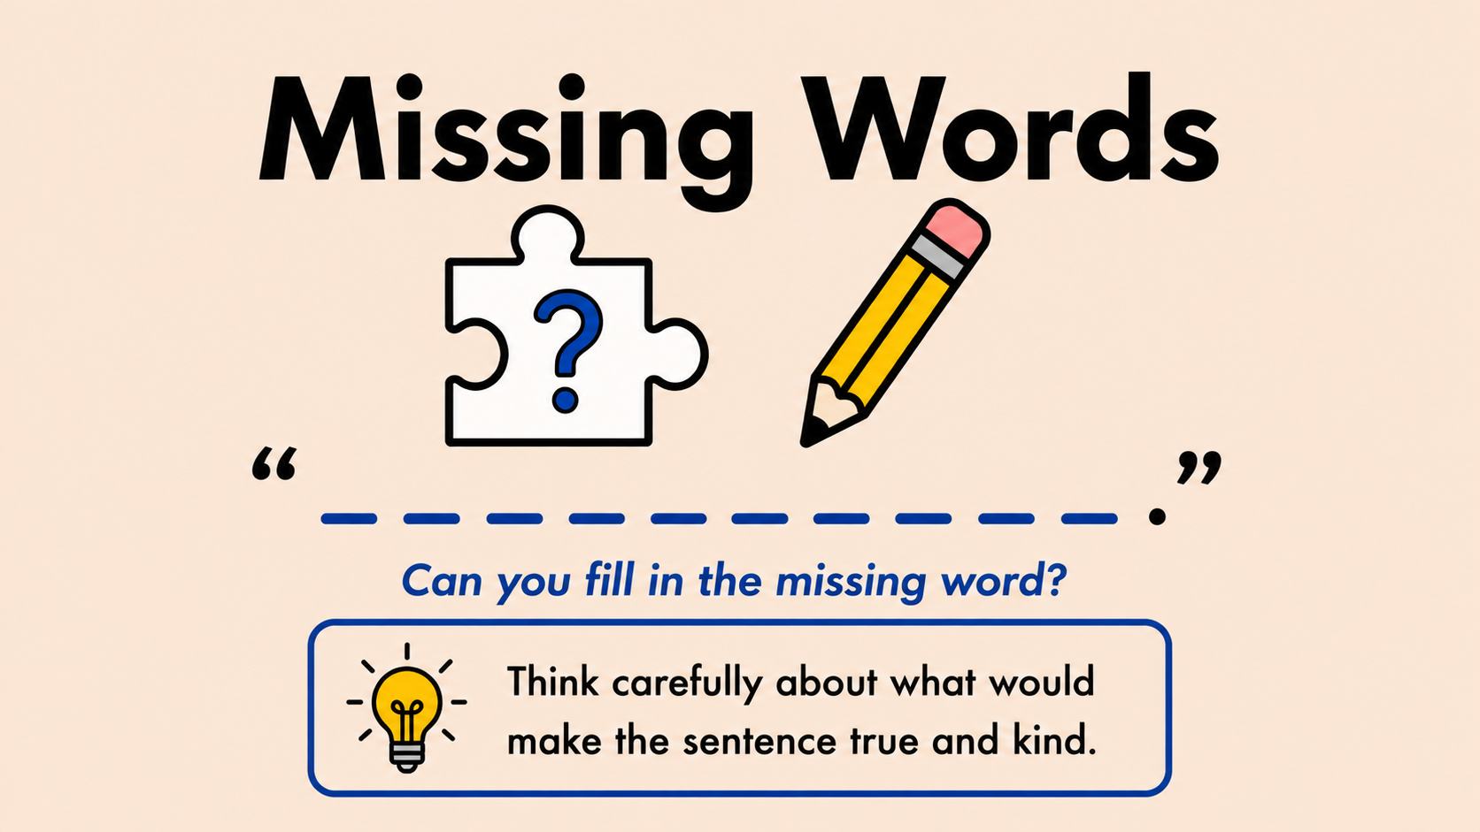

Slide 34
Task: Fill in the blanks using the word bank.
Word Bank:
light
reuse
creation
animals
recycle
__________ are part of God’s creation.
I can __________ things instead of throwing them away.
I can turn off the __________ when I leave a room.
God asks us to care for __________.
We should ______ what we already have.
Challenge: What could you reuse today?

Slide 35
Task: Fill in the blanks using the word bank.
Word Bank:
world
care
God
help
water
_______________ made the world.
I can _______________ for God’s creation.
Plants need _______________ to grow.
I can _______________ our Earth.
The _______________ is our Common Home.
Challenge: How can you help the world?

Slide 36
Task: Fill in the blanks using the word bank.
Word Bank:
share
protect
waste
future
home
We should not __________ water or other resources.
We can __________ what we have with others.
We can __________ plants and animals.
We care for the Earth now and for the __________.
The Earth is the __________ we all share.
Challenge: Who are we caring for when we look after the Earth today?

Slide 37


Slide 38

Discussion 1 — The Shared Paper Box
The art table is nearly out of paper. Some pupils want to use lots for one project. Other pupils still need paper for their work.
Possible prompts:
What would help the whole class?
What would be fair?
How can we care for shared resources?
Can everyone still create something beautiful?
Challenge: Does stewardship mean never using resources — or using them wisely? How can we do this?

Slide 39
Discussion 2 — The Forgotten Plant
A classroom plant is dry and drooping. Everyone thought somebody else would water it.
Possible prompts:
Why do shared responsibilities sometimes get forgotten?
What happens when nobody takes responsibility?
How can communities help living things flourish?
Who helps care for our school community every day?
Challenge: What could happen if everyone waited for somebody else to care?

Slide 40


Slide 41

What is Stewardship?
Stewardship means caring for the Earth, people, and living things
because creation is a gift from God. We help our Common Home
flourish when we protect and care for it together.
Finish the sentences in your own words:
I can help creation flourish by…
I can care for our Common Home when I…
I can protect living things by…
Challenge: Stewardship matters because…
For lots more activities and scaffolds, see the Stewardship of Creation Resource Booklet.

Slide 42

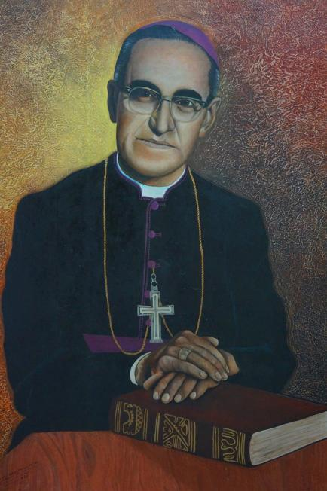
CAFOD & St Oscar Romero
CAFOD has a special connection with St Oscar Romero and the people of El Salvador. When Romero's radio station was bombed, CAFOD helped to rebuild it so that his message of justice could continue to be heard.
Explore further with CAFOD:
Discover Romero's life through CAFOD's animation, primary teaching resources, Romero Cross activity, poster and timeline, prayer and worship resources. Available at: St Oscar Romero teaching resources for schools
Want to explore further? See the ORA Stewardship of Creation Resource Booklet for differentiated questions, activities and further exploration of CST and St Oscar Romero.

Slide 43

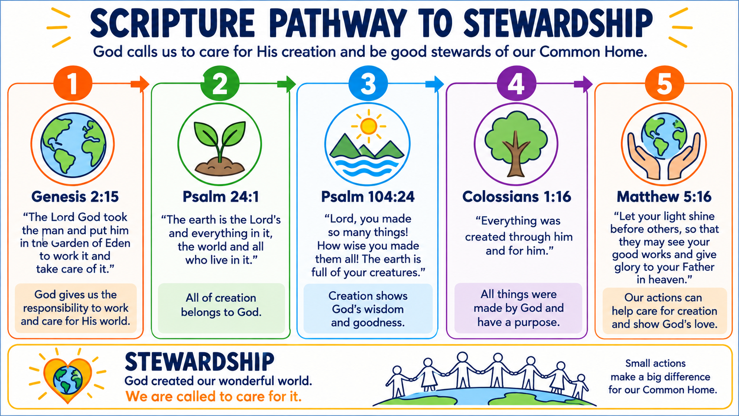
(For more detail and scripture references for use with prayer and liturgy see PPT notes)
Notes:
Further Scripture on Stewardship of Creation — Good News Bible
Genesis 2:15 – “Then the LORD God placed the man in the Garden of Eden to cultivate it and guard it.”
God gives people responsibility to care for and protect creation.
Genesis 1:31 – “God looked at everything he had made, and he was very pleased.”
Creation is good and precious because it comes from God.
Psalm 104:24 – “LORD, you have made so many things! How wisely you made them all! The earth is filled with your creatures.”
The variety and beauty of creation show God’s wisdom and goodness.
Psalm 24:1 – “The world and all that is in it belong to the LORD; the earth and all who live on it are his.”
The world belongs to God; people are called to care for what has been entrusted to them.
Psalm 96:11–12 – “Be glad, earth and sky! Roar, sea, and every creature in you; be glad, fields, and everything in you! The trees in the woods will shout for joy.”
Creation itself is pictured as praising God.
Psalm 147:8–9 – “He spreads clouds over the sky; he provides rain for the earth and makes grass grow on the hills. He gives animals their food and feeds the young ravens when they call.”
God cares for creation and provides what living things need.
Psalm 8:6–8 – “You appointed them rulers over everything you made; you placed them over all creation.”
Human beings are given responsibility within creation, which should be exercised with care.
Leviticus 25:23 – “Your land must not be sold on a permanent basis, because you do not own it; it belongs to me.”
The earth is ultimately God’s, not ours to use without limits.
Matthew 6:26 – “Look at the birds: they do not plant seeds, gather a harvest and put it in barns; yet your Father in heaven takes care of them!”
Jesus reminds us that God values and cares for living creatures.
Romans 8:19 – “All of creation waits with eager longing for God to reveal his children.”
St Paul presents creation as sharing in God’s purposes and longing for renewal.
Colossians 1:16 – “For through him God created everything in heaven and on earth, the seen and the unseen things.”
Christ is at the heart of creation; caring for creation is part of honouring God.

Slide 44

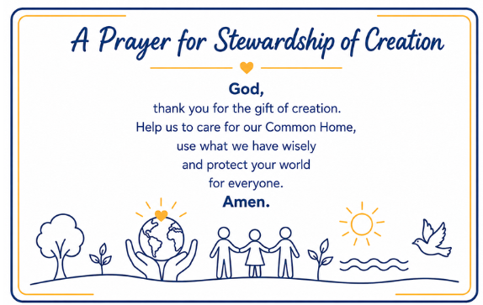
The following slides contain some simple written prayers that can be used for individual, group or whole class use. These are followed by some prayer templates that can be adapted for use in a variety of ways. The Prayer for Stewardship of Creation can be shared with everyone.
Please see the Oscar Romero Stewardship Resources PPT for more prayers

Slide 45
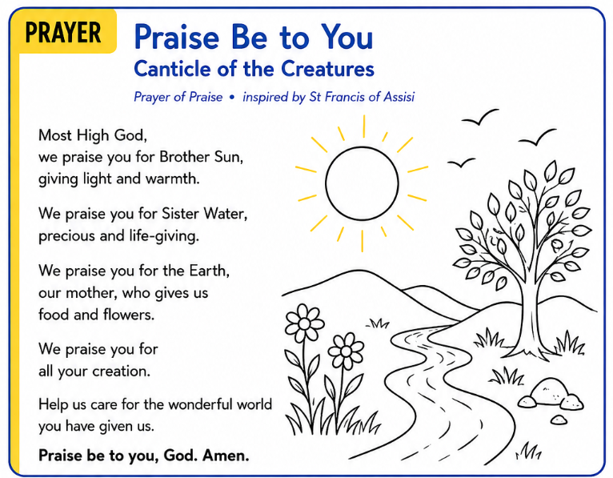

Slide 46
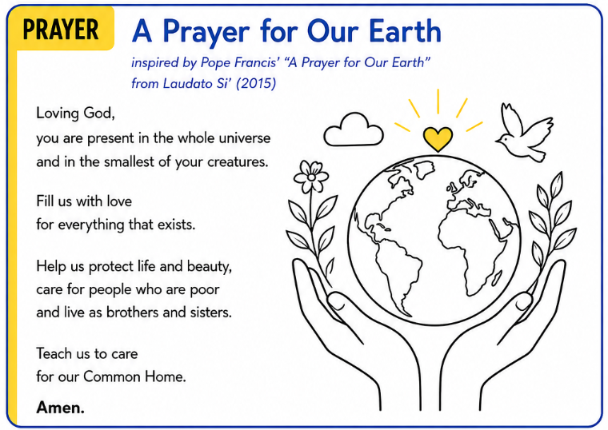

Slide 47
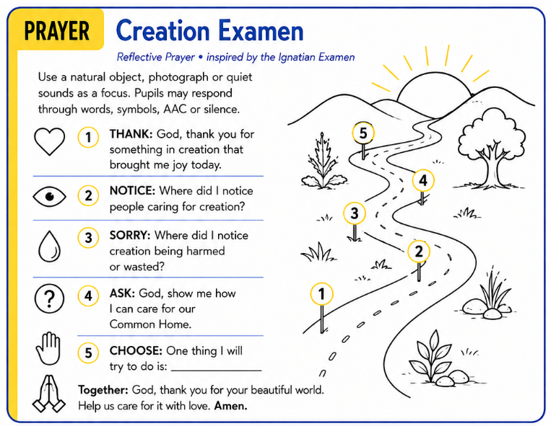

Slide 48
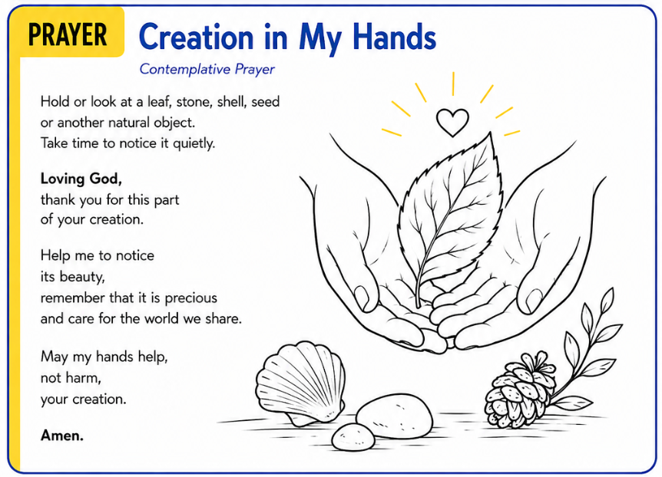

Slide 49
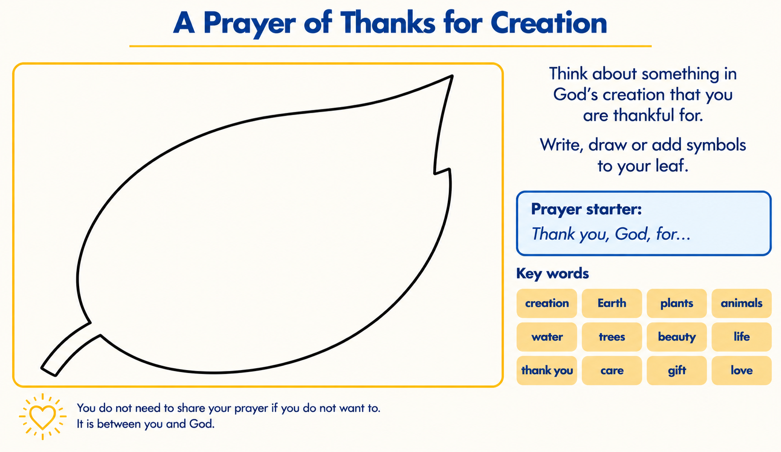

Slide 50
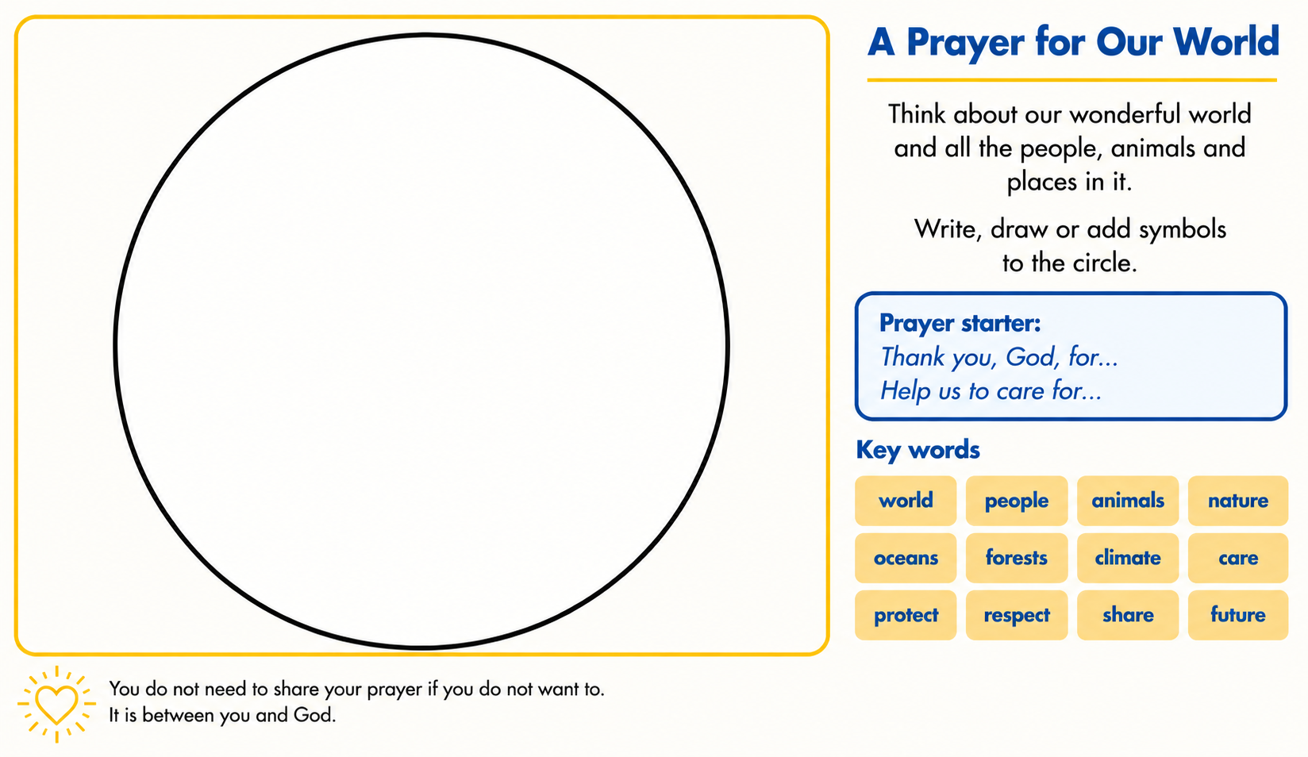

Slide 51
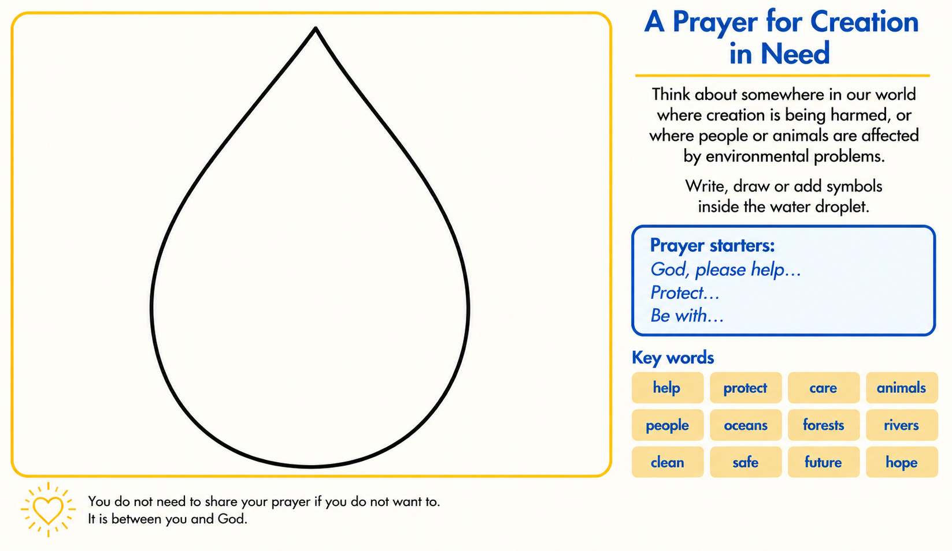

Slide 52
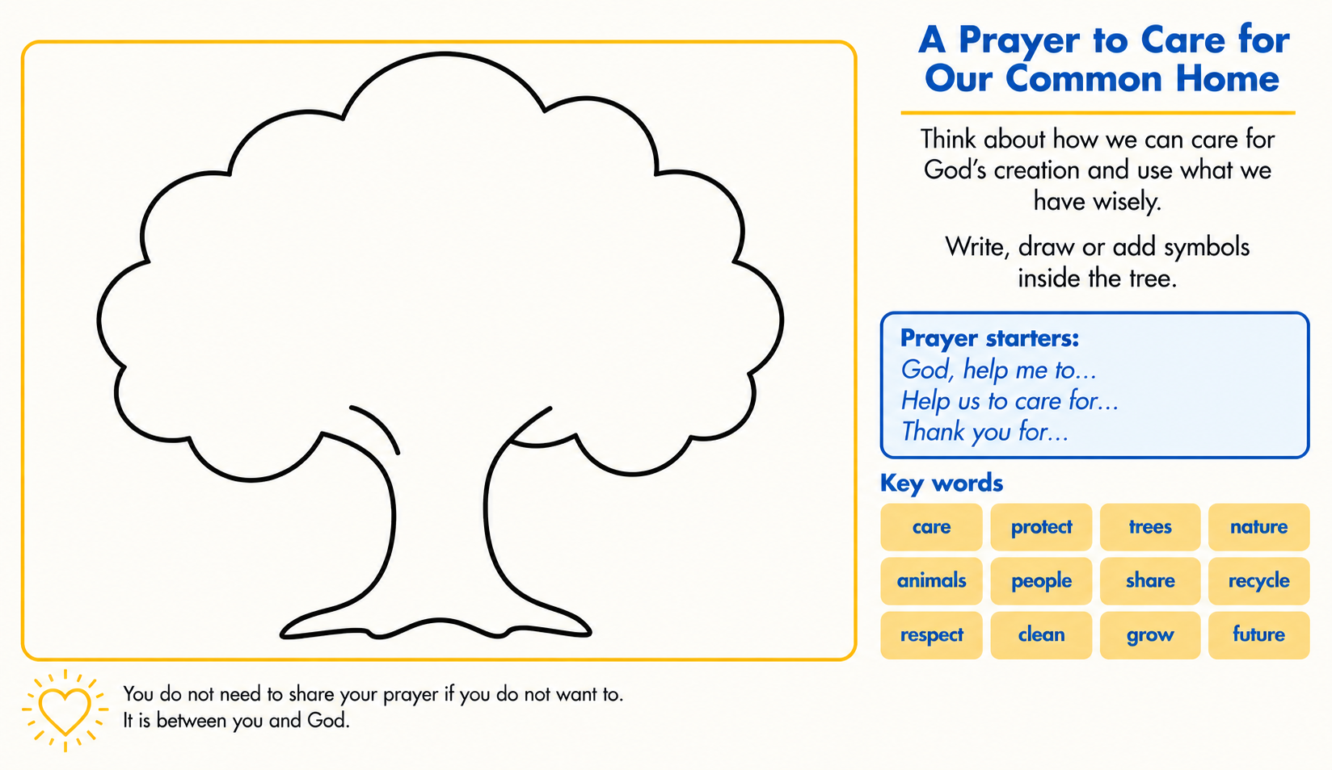

Slide 53
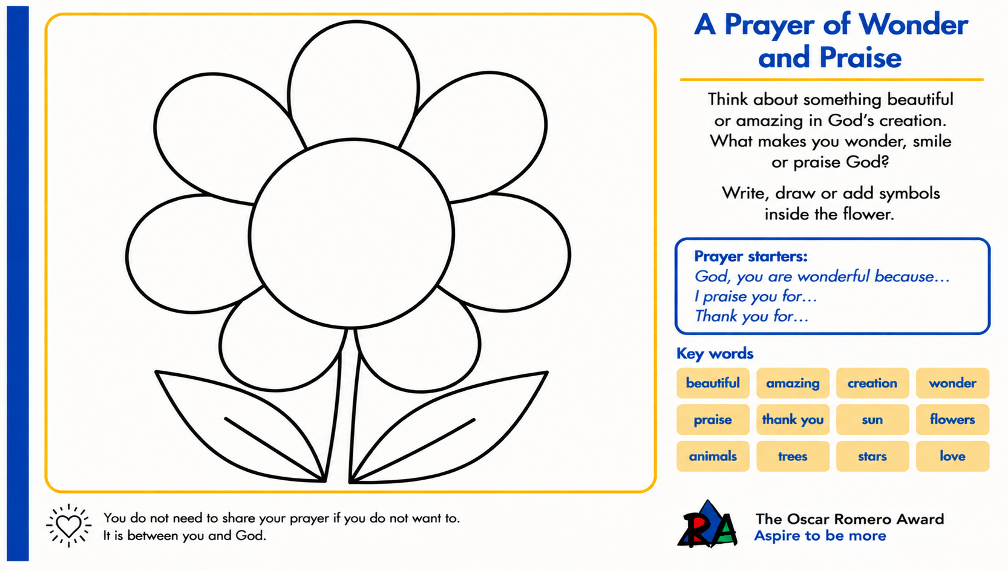

Slide 54

More challenging songs for Prayer & Reflection (or general background music)
Laudato Si’ song from CAFOD
So Will I (100 Billion X) — Hillsong UNITED “If creation sings Your praises, so will I.”
Indescribable — Chris Tomlin “From the highest of heights to the depths of the sea, creation’s revealing Your majesty.”
Love Song to the Earth — Paul McCartney et al. “This is a love song to the Earth, You're no ordinary world...Keep it safe.”
Wonder — Hillsong UNITED “I see the world in light, I see the world in wonder.”
Creation Sings the Father’s Song — Keith & Kristyn Getty “His fingerprints in flakes of snow, His breath upon this spinning globe.”
For a short list of traditional songs related to Stewardship of Creation for singing or listening during prayer and liturgy, see PPT notes
Notes:
Songs linked to Stewardship
Pupils could sing or listen to songs linked to Stewardship such as:
• If I Were a Butterfly, Brian Howard
• Wonders I See, Bernadette Farrell
• Praise Him, Praise Him
• Our God is a Great Big God
• Laudato Si’ O Mi Signor
• How Great Thou Art

Slide 55

Protect God’s World Song (Tune: He’s Got the Whole World in His Hands)
1. The Whole World 🌍
We’ve got the whole world in our hands ×3
We are here to protect God’s world.
2. Creatures 🐝
We’ve got the birds and the bees in our hands ×3
We are here to protect God’s world.
3. Nature 🌳
We’ve got the plants and the trees in our hands ×3
We are here to protect God’s world.
4. Love and Care ❤️
We’ve got to love and care for the Earth ×3
We are here to protect God’s world.
5. Stewards 🤝
We are stewards of the world, here to protect ×3
We are here to protect God’s world.

Slide 56
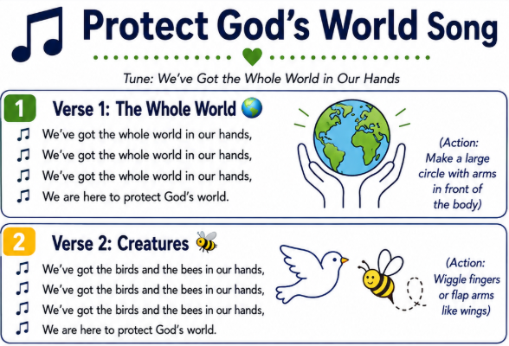

Slide 57
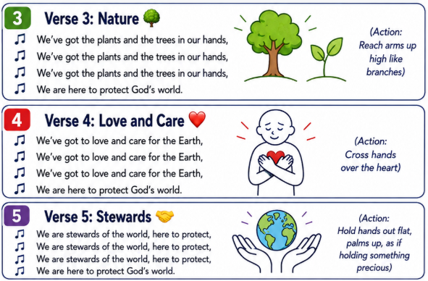

Slide 58


Slide 59

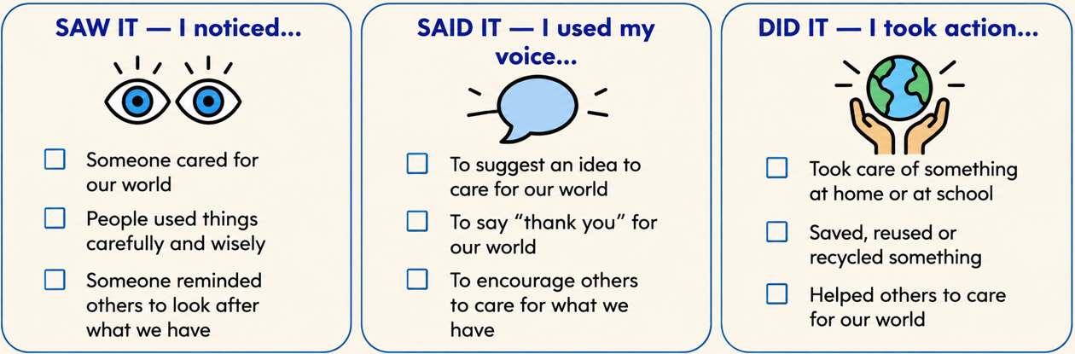

Slide 60
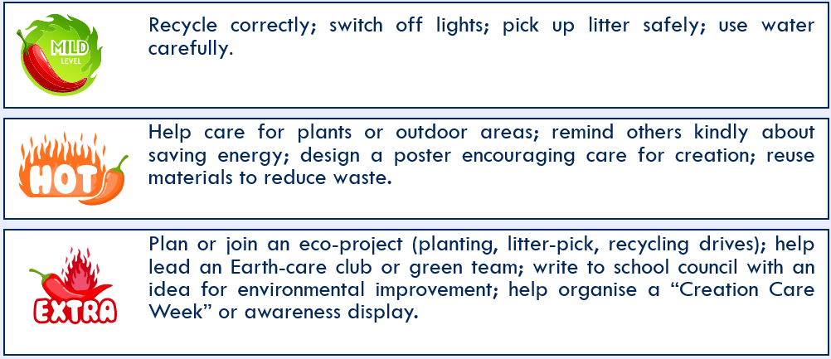
Further ideas and extensions
Please see the Oscar Romero Stewardship Resources PPT for more support

Slide 61

From the Oscar Romero Award Trust
The Oscar Romero Award Trust provides further resources to help schools explore, embed and live out Catholic Social Teaching across school life. These are available at www.romeroaward.co.uk/resources and include:
CST Mapping to the RED – Explore connections between the CST principles and the Primary Religious Education Directory (RED).
Celebrations of the Word – Ready-to-use prayer resources for each CST principle for primary and secondary pupils.
CST Resource Packs – Ready-to-use resources for each principle to support teaching and CST displays.
Special Times Resources – Resources for significant occasions including the Feasts of St Romero and St Joseph.

Slide 62

CAFOD offers a wide range of free resources to help children understand, explore and put Catholic Social Teaching into action. These complement the Oscar Romero Award resources and are available at: CAFOD Catholic Social Teaching resources
Meet Sofia the Sloth – Explore Stewardship through Sofia’s Caring for God’s Gifts nursery rhyme, encouraging children to care for the earth. CST Nursery Rhymes on CST PowerPoint
See Stewardship in Action – Meet Dristy in Bangladesh and other children around the world caring for creation and their communities. Children taking care of creation
Explore More – CAFOD’s Stewardship and Laudato Si’ resources include stories, animations, prayers, posters, pledges, songs and activities for caring for our Common Home. Laudato Si’ resources for children and Laudato Si’ song
See also: Laudato Si for schools and Laudato Si animation for children
Laudato Si for young people and Canticle of the Sun prayer

Slide 63

