Slide 1

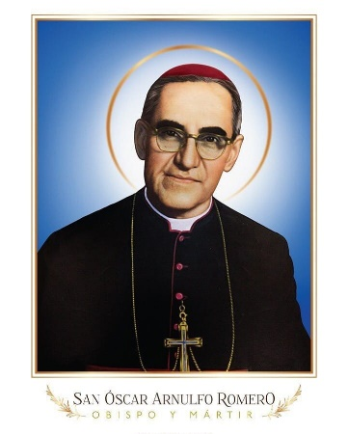
The Oscar Romero Award for Catholic Schools and Colleges
…helping Catholic schools and colleges to put Catholic Social Teaching into action

Slide 2

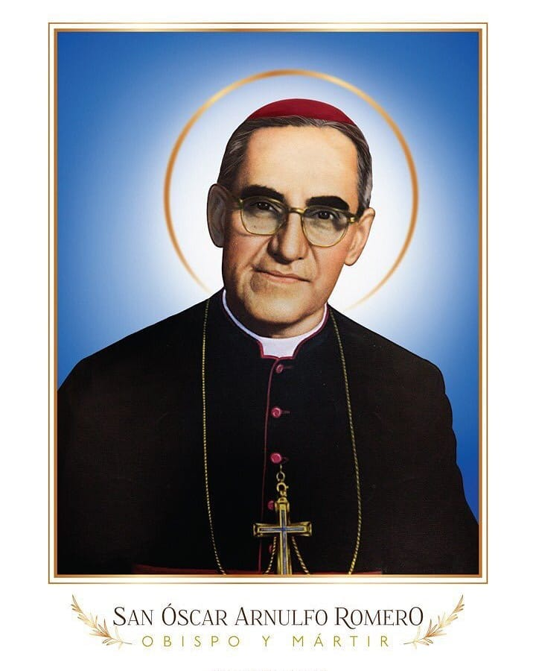
Why St Oscar Romero?
Working in El Salvador in late 1970s, Archbishop Oscar Romero stood up for the rights of the poor and oppressed. He reminded leaders that ALL people were important and must be respected.
He was killed on 24 March 1980

Slide 3
Why St Oscar Romero?
Our Award is inspired by St Oscar Romero because he was…
The “voice of the voiceless’’
…and asked us to,
“aspire not to have more but to be more.”
http://www.romerotrust.org.uk/ - St Oscar Romero

Slide 4
On our part, we too are…
Called to become…
A ‘voice for the voiceless’ and demand justice on their behalf.
Encouraged to…
“Aspire not to have more but to be more”

Slide 5
The aim of the Award
To help a school recognise and celebrate all it does as a Christian community that enables individuals in its community and beyond to live life to the full
To challenge a school to continue finding ways of being ‘good news’ to all in its community and beyond

Slide 6
The Oscar Romero Award
– the Strands
This Award is for the whole school; pupils, staff and families and it covers everything that happens in the school
Strategic/Leadership Strand: It asks a school to consider what is at the heart of the decision it takes, what is driving the school?
Curriculum Stand: It challenges a Catholic school to use the curriculum as a tool of teaching certain values about life
Practical Strand: what else happens in the school, and how does this ‘enhance life’ as taught by Jesus?
The Award holds that if a school puts Catholic Social Teaching principles at the heart of these three areas, then that school would be a wonderful community

Slide 7
The 3 Strands of The Oscar Romero Award
Curriculum
Practical
Strategic
CST informs how and what is taught
CST informs the decisions the school makes
How the school puts CST into action
Notes:
Focusing on putting CST principles into practise in a school will have a huge impact/influence on the community
Staff will be happy and pupils will be happy and parents will be happy too.
CST principles engage everyone in the school regardless of their faith – these principles are acceptable to all
We use the curriculum to teach our values - CST

Slide 8
The Oscar Romero Award
– the Levels
This Award is available at THREE levels, participator, Developer and Innovator, with each level building on the previous one.
Participator Level: our belief is that nearly all Catholic schools are at this level because it focuses on the very basic things that should be happening in any Catholic school.
The colour for this level is BLUE: it represents the colour of the sky, what is all around us. Liturgically, this is the colour for the Blessed Virgin Mary, our Mother. St Oscar Romero had a special devotion to Mary.
It is therefore about what should be around the school – what should be the norm.

Slide 9
The Oscar Romero Award
– the Levels
Developer Level: At this level, the school is challenged to develop ways of putting CST into action in their school, with most of the policies and curriculum areas explicitly referencing CST principles
The colour for this level is GREEN: it represents the liturgical colour of Ordinary Time, a time when we grow in faith. Green is also a colour of fruitfulness, growth and development.
This level is therefore about a school building up on their call to be places of faith development, helping each person to live life to the full. We believe that focus on CST principles will help a school become such a place.

Slide 10
The Oscar Romero Award
– the Levels
Innovator Level: At this level, CST principles are seen in action in all areas of the school, and the school is sharing this with other schools, they are being missionary.
The colour for this level is RED: Liturgically, the colour of the Holy Spirit (Pentecost) and the fire of inspiration as well as stepping out and sharing the Good News. It is also the colour of martyrs, and St Oscar Romero is a martyr.
At this level, the school takes on a missionary element of our faith, sharing with other schools or communities the fruits of embedding CST principles, helping them to also embed CST principles.

Slide 11
3 Levels of The Oscar Romero Award
Participator
Level
CST is implicit in the school at different levels
Developer
Level
CST is explicit in most areas of the school
Innovator
Level
CST is embedded in the school and works with others to promote CST
Registration
There is no time limit but once you get the Innovator Level, you will need to renew it every 3 years
Start here
Notes:
This is a journey for the school – it is not a one off moment,
It is a process of change.
A school cannot jump levels.

Slide 12
Our fees…
To facilitate the smooth running and sustainability of the Award, we have an annual subscription fee:
Primary schools £150
Secondary schools/Sixth form colleges £300
All through schools £400
Available resources include exemplars from other schools, support (in person, video call) from our Validators and Coordinator, resources on CST, links to other websites

Slide 13
To get started…
Visit our website to read more about the Award
To register, please use the “Apply (New Schools) tab on the top right side of the website
You will then be invited to complete your payment
Once this is complete, you will be given a login details to our resources section
And you will also be given access to an application form for the Participator Level

Slide 14
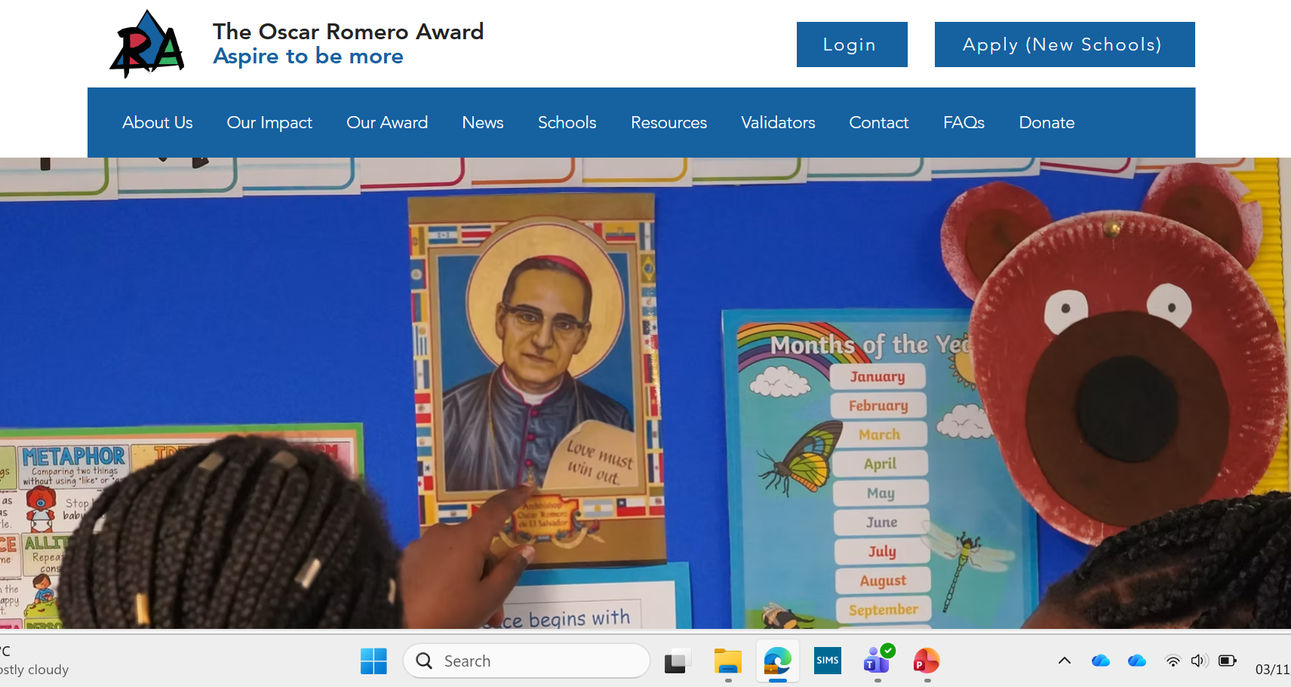
www.romeroaward.co.uk

Slide 15
Reach out to us…
Coordinator - Mugeni Sumba
Contact@romeroaward.co.uk
Administrator – Nina McCormack
Admin@romeroaward.co.uk
C
P
S
Our learning
Our decisions
“Everyone who struggles for justice, everyone who makes just claims in unjust surroundings is working for God’s reign…”
St Oscar Romero
Our actions

