Slide 1
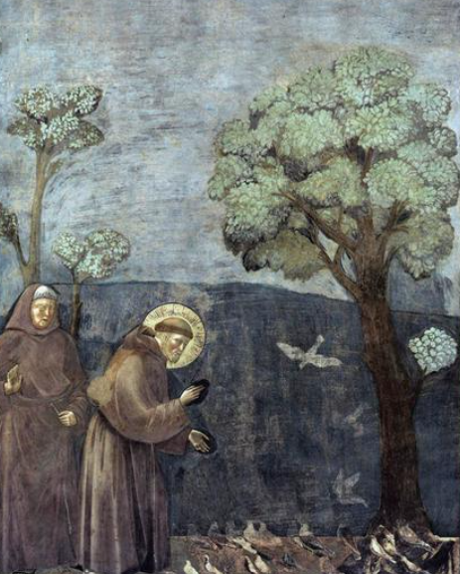
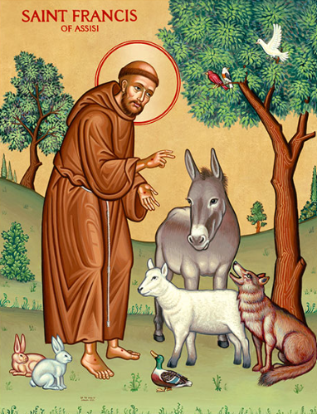
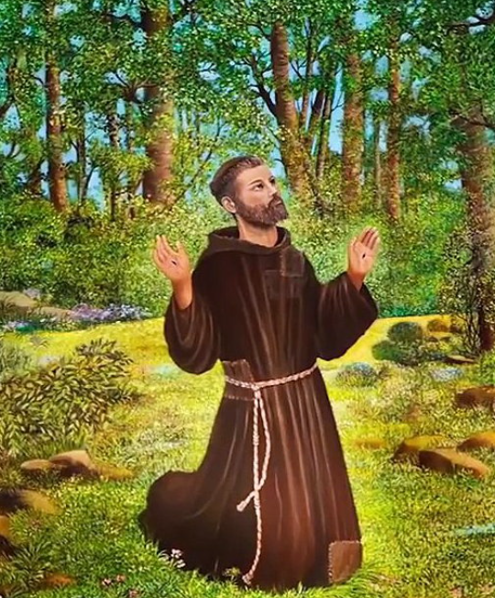

Year of St Francis

Slide 2

Gather
Laudato Si’
O Mi Signor
(Praise be to you, O my Lord)

Slide 3
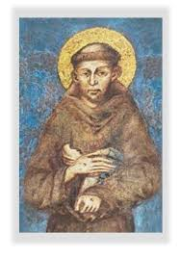
Gather
St Francis continues to call the Church to care for the poor, protect our common home, and live with greater simplicity and responsibility. How are you called to live these values in your own life?
How are you called to live these values in your own life?

Slide 4

Listen
“Praise the Lord from the heavens;
praise him in the heights.
Praise him, sun and moon;
praise him, all shining stars…
Praise the Lord from the earth,
sea creatures and all depths…
Let them praise the name of the Lord,
for he commanded
and they were created.”
(Psalm 148)

Slide 5

Listen
https://www.youtube.com/watch?v=3X4tv19Muk4 A prayerful reflection inspired by St Francis’ Canticle of Creation (CAFOD).

Slide 6
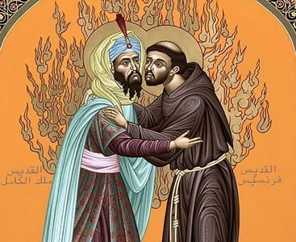
Respond
During the Crusades, when Christians and Muslims were in violent conflict, St Francis travelled to meet the Sultan Malik al-Kamil.
Instead of seeing him as an enemy, Francis approached him with humility and respect. He listened, spoke peacefully, and recognised the Sultan’s dignity as a fellow human being.

Slide 7








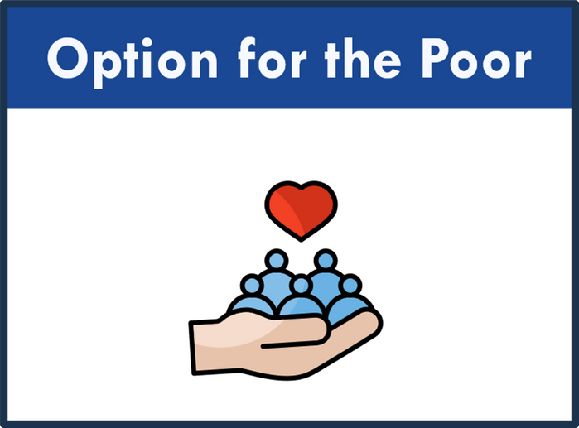
Respond

Slide 8
Respond

Slide 9

Reflecting on
St Francis
• How do my daily choices affect other people and the environment?
• Where might I be called to live more simply or responsibly?
• What does it mean to be a peacemaker in today’s world?
• How can I use my voice or actions to protect dignity and creation?

Slide 10

Respond
  Reader: We will now pray together using an adapted prayer inspired by St Francis’ Canticle of Creation. Different voices will help us praise God for His world.
  Child 1: Praise be to you, God, for Brother Sun, who gives us light and warmth. All: Help us care for your world.
  Child 2: Praise be to you, God, for Sister Moon and the stars, shining in the night sky.
  All: Help us care for your world.

Slide 11
  Child 3: Praise be to you, God, for Brother Wind and the air we breathe, for clouds and rain.
  All: Help us care for your world.
  Child 4: Praise be to you, God, for Sister Water, so precious and life-giving. All: Help us care for your world.
  Child 5: Praise be to you, God, for Sister Earth, who feeds us, supports us, and gives us life.
  All: Help us care for your world.
Respond

Slide 12

Let us pray...
God of creation,
Teach us to live simply,
to care deeply,
and to walk gently with one another
and with the Earth.
Through the example of St Francis,
help us be people of
peace, care and hope.
Amen.

Slide 13

Mission: St Francis
• Make one change this week that reduces harm to the environment.
• Act as a peacemaker in a situation of tension or conflict.
• Stand in solidarity with someone who feels excluded or unheard.
• Reflect on one habit that needs to change for the good of others.
Or choose your own mission.

Slide 14
Send Forth
Make me a channel of Your peace

